Slide 1
Notes:
Slide de inicio de la presentación

Slide 2
Indra Onesait utilities

Slide 3
Indra’s timeline
1993
2011
2016
2018
Indra’s foundation.
Indra acquires Politec, a Company with relevant position in the Energy, Financial Services and Public Administration vertical markets in Brazil.
Indra launches Minsait Brand. Indra has grouped its technology and consultancy solutions in the digital business into Minsait.
Indra acquires Paradigma (leader in the native digital format with agile work methodologies and an innovation culture) completing Minsait's value proposition.
Indra acquires ACS*, with this acquisition, Indra accesses the markets of the United States and Canada.
* ACS Advanced Control Systems

Slide 4
Indra
Defense and Security
Air traffic
Transport
Minsait
Supports these industries
acquires
Industry and Consumption
Public Administration
Paradigma
Energy
and
Oil & Gas
ACS
Utilities Water
Strengthen Minsait’s portfolio for utilities
Utilities Electricity & Gas
Telco & Media
Financial Services
Notes:
https://www.minsait.com/es/industrias/utilities-electricidad-gas
https://www.minsait.com/es/industrias/utilities-agua

Slide 5
Indra in a nutshell
Sales (2017):
3,011 billion euros in 2017
R&D: 5%-8% over sales
+200 agreements with research centers and universities
+1.000M Euro in R&D (2011 – 2017)
+140 countries
40,000 employees
14%
AMEA
16%
Europe
50%
Spain
20%
America
T&D
TI
Financial Services
Public Admin & Healthcare
Energy & Industry
Telecom & Media
Transport & Traffic
Defense & Security
19%
20%
20%
17%
16%
8%
Sales (2018)
2017
18%
20%
21%
14%
19%
8%
2018

Slide 6
Indra’s Factsheet
Minsait (IT) registered order intake (+10%) and revenue (+9%) growth. Digital solutions sales increased by +28%.
2018 Energy & Industry revenues increased by +25%. The growth reached by key clients in both the Utilities (Enel) and the Oil & Gas (Repsol) sectors, as well as the Hotels sector.
By geography, Spain (c. 55% of sales) and America (c. 25% of sales) concentrated most of the activity Sales.

Slide 7
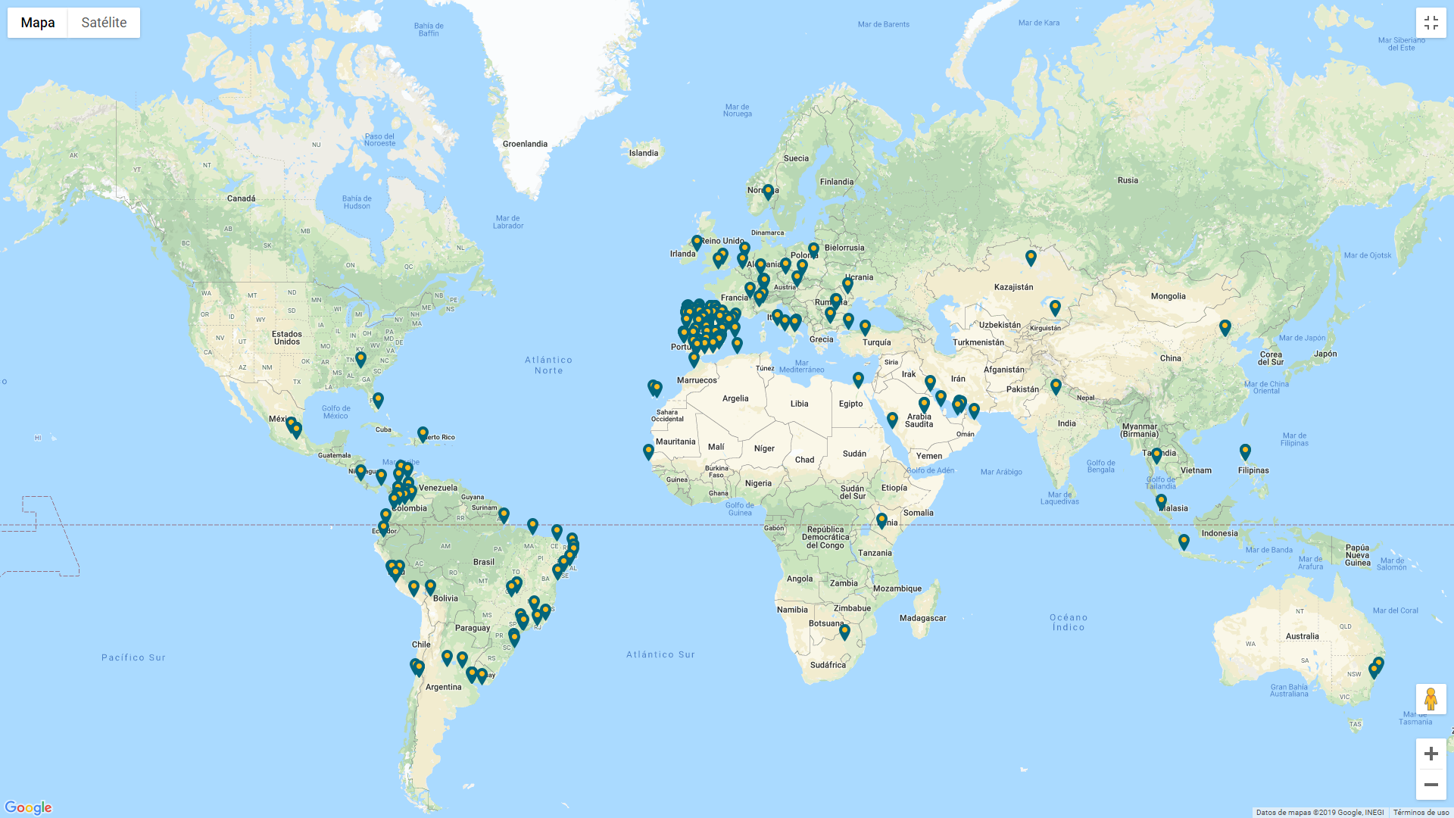
Worldwide Offices
Minsait's energy solutions have been implemented in more than 300 electricity, water, oil and gas companies in 45 countries. Currently, more than 150 million customers worldwide are managed using the commercial or network system developed by Indra's company.
Indra, Minsait will help the Equatorial Guinea electricity, 2019.
+140 locations globally

Slide 8
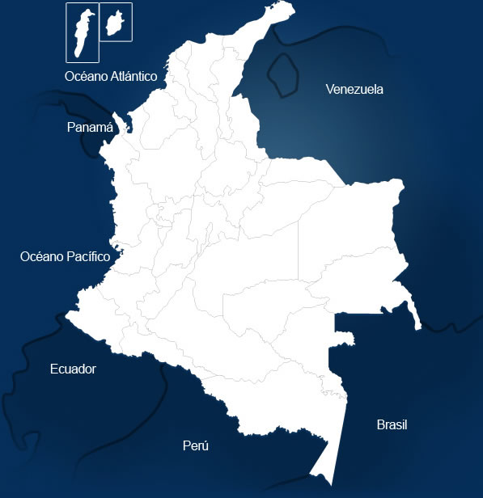
Indra’s Offices in Colombia
+3,000 profesionales
“Centro de Excelencia Cloud” in Bucaramanga
CyberSecurity Operations Center or i-CSOC in Bogotá
Delivery Center in Pereira
(Software Production Center)
Notes:
En Colombia, donde está presente desde hace más de 20 años, Indra es una de las principales compañías tecnológicas del país. Cuenta con más de 3.000 profesionales y dispone de oficinas en Bogotá, Barranquilla y Medellín, así como un Centro de Excelencia Cloud en Bucaramanga y un Delivery Center (Centro de Producción de Software) en Pereira, que funciona como un polo tecnológico para el desarrollo de proyectos emergentes y arquitecturas punteras que se exportan a toda Latinoamérica y otros países bajo los más altos estándares de calidad, como CMMI y TMMI.
Además, la compañía tiene un Centro de Operaciones de Ciberseguridad (CyberSecurity Ope-rations Center o i-CSOC) en Bogotá, con el que ha reforzado su liderazgo en el mercado de ciberseguridad dentro de Latinoamérica, apoyando la actividad de sus clientes en la región y ofreciendo a las compañías locales servicios especializados.

Slide 9
Indra’s Awards
2017
2017
Tmforum singled out Minsait IoT Platform Sofia2, a platform with big data and cloud capabilities, for most innovative smart city IoT platform worldwide. This is the second consecutive year that TM Forum has honored the platform. In 2016 Indra won the "Open Digital Ecosystem Platform of the Year" award.
Minsait reached CMMi level 5 in Spain, Colombia, Mexico and Peru for Advanced Application Management Services, User Support and Projects.

Slide 10
Current Growth Drivers
Indra is committed to focus on value propositions that integrate end-to-end solutions.
End-to-end solutions
Business model
Technology
Expertise
The renewal of the structure of the commercial offer aims to support ad respond to key objectives for Indra, such as:
A new specialized operational and organizational model for the company and its businesses.
The boosting of the evolution of the products and the transformation of the offer.
Clients
Solutions
New commercial processes and tools to strengthen the growth of sales.
Actions for improvement in efficiency and productivity to improve operating margins.
Source: Indra, Indra simplifies its sales portfolio structure by segmenting it and making it even clearer, 2018.

Slide 11
Corporative programs
Smart Start includes specific professional training, development, evaluation and progression programmes: for the first two years at Indra. It Includes: Orientation programme, feedback every six months, specific training in technology, mentoring programme for career trajectory, specific remuneration policy for people in the programme.
“Semillero” Program
Indra Open University includes an advanced virtual campus, which facilitates continuous self-learning and adjusts training to each individual by offering new content, tools and methodologies.
Open Academy
Program for professionals around the world to respond to specific innovation challenges in areas where the company wants to be a pioneer in order to strengthen its technological leadership
Indra offers different career plans that will allow employees to design their own professional development. From strategic consulting to technological support, to functional and technological consulting, business careers, project management and expertise.

Slide 12
Benchmarking results

Slide 13
7. Key Activities
1. Value proposition
3. Customer
relationships
2. Customer segments
8. Key partners
ALLEGRO
ANDANTA, S.L.
ARION
CISCO
GOOGLE
HCL
INTEL
ZIGBEE
CA Technologies
ESRI
IBM
SAS
Adquisitions
R&D
Software development
Sales
Services and consulting
Onesait Utilities Suite:
Plants &Energy Management
Grid Management
Smart Metering
Customer Management
Prosumers
Workforce
ACS
Service & Consulting:
Strategic Consulting
Digital Consulting and technology
ERP Consulting
Cybersecurity
Operations
Events
Sales representatives
Partners (Sales & Implementation, and IT)
By region:
America
Europe
Asia
By services:
Energy, water, gas and multiservices
Detail…
Detail…
6. Key Resources
4. Channels
Patents and innovations
Web page
Phone
Email
Social media
Detail…
Detail…
Detail…
Detail…
9. Cost structure (€M)
5. Revenue streams (€M)
Materials used and other supplies and other operating expenses (1,290.5)
Staff Costs (1,606.9)
Indra: Revenue 3,103.7
Minsait: Energy & Industry 580
Detail…
Notes:
Se incluye solo la oferta actual. En el detalle de productos, veremos la oferta anterior.
US$40 billion total GAAP
revenue in FY 2018

Slide 14
Actions to take
Diapositiva para apertura de tema

Slide 15
Open should…
Marketing messages
Corporate strategies
Product Development
Highlight:
Successful Implementation cases to take advantage of Indra’s bad experience in ENEE.
Clients’ reviews about support services due to some of Indra’s clients complain about this aspect according to Gartner.
The Fort Collins Project as a project developed in the United States, because Indra does not have a CIS experience in this country.
User interface due to some versions of Indra’s products seem obsolete.
InCMS and Minsait product portafolio have not been implemented yet.
Involve its customers in an Innovation program, creating challenges to solve their main issues. Likewise, Open should stablish strategic alliances to deploy technological projects, specially to develop energy efficiency projects.
Assist Smart Utility Summit events due to its relevance in the industry.
Work on the adoption of an IoT platform.
Analyze new business models that are emerging from the integration of new elements and technologies such as distributed energy resources, smart metering, prosumers, and smart home applications.
Manage load profiles and strengthen Meter Data Analytics, especially for demand forecasting, fraud patterns, and failures’ detection. Likewise, it should analyze if variables such as temperature, humidity, light intensity apply for residential customers.
Strengthen control of losses developing capabilities for losses identification, simulation of losses/ Cost scenarios, energy balance, potential customer fraud, monthly non-payment risk.
Research deeper the Electric vehicles trend to stablish how OSF should support the creation of energy efficiency plans that involve an electric vehicle. Likewise, the way OSF should support metering capabilities for an electric vehicle and DR Programs.
Research deeper Complex Event Processing to identify the business scenarios that need processing data in real-time.

Slide 17
Detailed results

Slide 18
Value proposition

Slide 19
1995
Open SGC (CIS)
InCMS (CIS)
InGrid (MDM)
2016
Minsait
Onesait Utilities
Indra has launched a new business unit called Minsait in which it has grouped its technology and consulting solutions in the digital business.

Slide 20
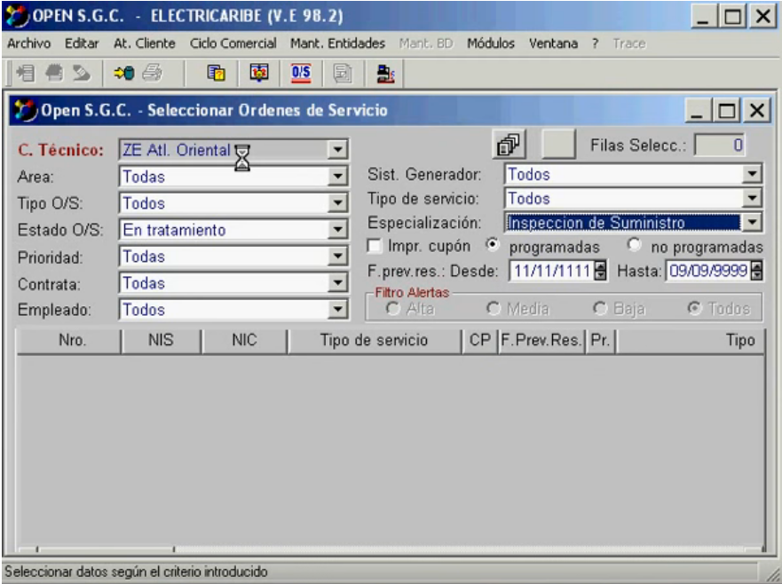
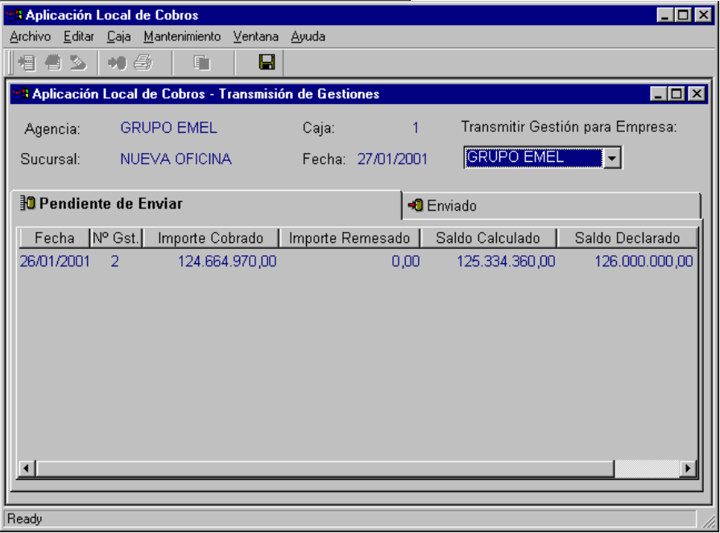
Open SGC (2014)
Customer Care
Meter reading
Billing
Bills Editing
Revenue
Collections
Management control
ERP
Financial interface
Features
Manage customer information (contract status, device data, balance, billing history, reading details, etc.).
Meter reading scheduling.
Manage meter reading anomalies.
Detect and manage billing anomalies.
Maintain Billing Data.
Manage collections processes and payment arrangements.

Slide 21
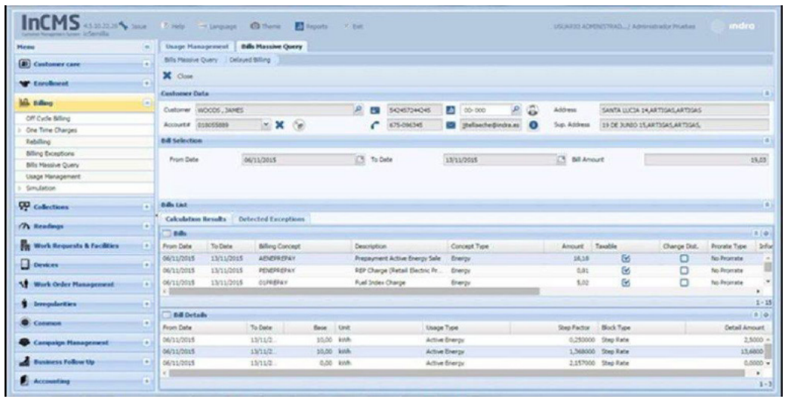
Indra InCMS (2015)
Multichannel Tools
Web channel
Integration IVR, fax, email, sms
E-payment Credit Card, ATM
Integration Mobile payments
CRM
Marketing and Sales
New conection and contracting
Billing
Collection and Debt Management
Complementary modules
Complementary modules
MOBILITY
Customization and Security
Mobile Reading Application
Reports and control
Conversion Tool
Distribution services
Billing on site
Dashboards
Reading
Devices Management
Field orders
KPI and control process report
Mobile field orders
Reading Adquisition
Reading Data Management
Consumption Determination
Transactional reports
Business intelligence
Integrations
Financial system
Document Management
AMR/MDM
InGrid OMS
InGrid WFM
Additional features
HCM System
Pre-Payment
InGrid DMS
IGEA GIS
Energy Control
InGrid AMP
InCMS, the CIS solution of Indra, included new following features in 2015:
On-site billing
Prepayment
Mobility
Full web – HTLM5

Slide 22
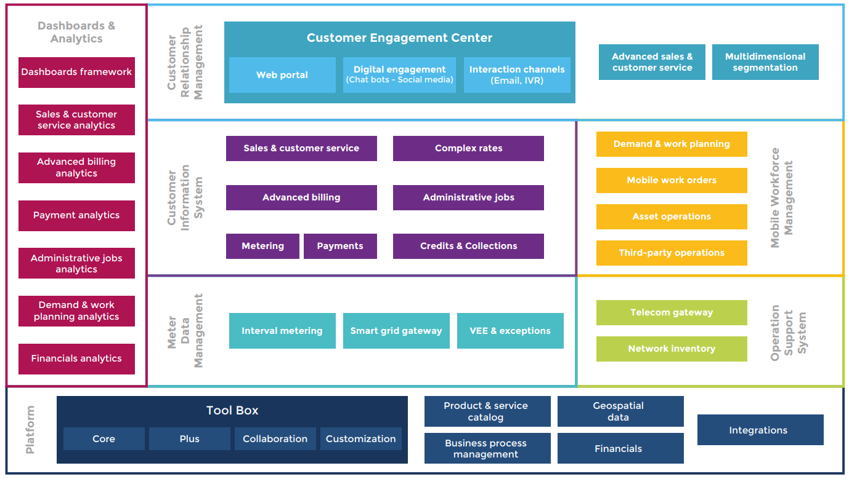
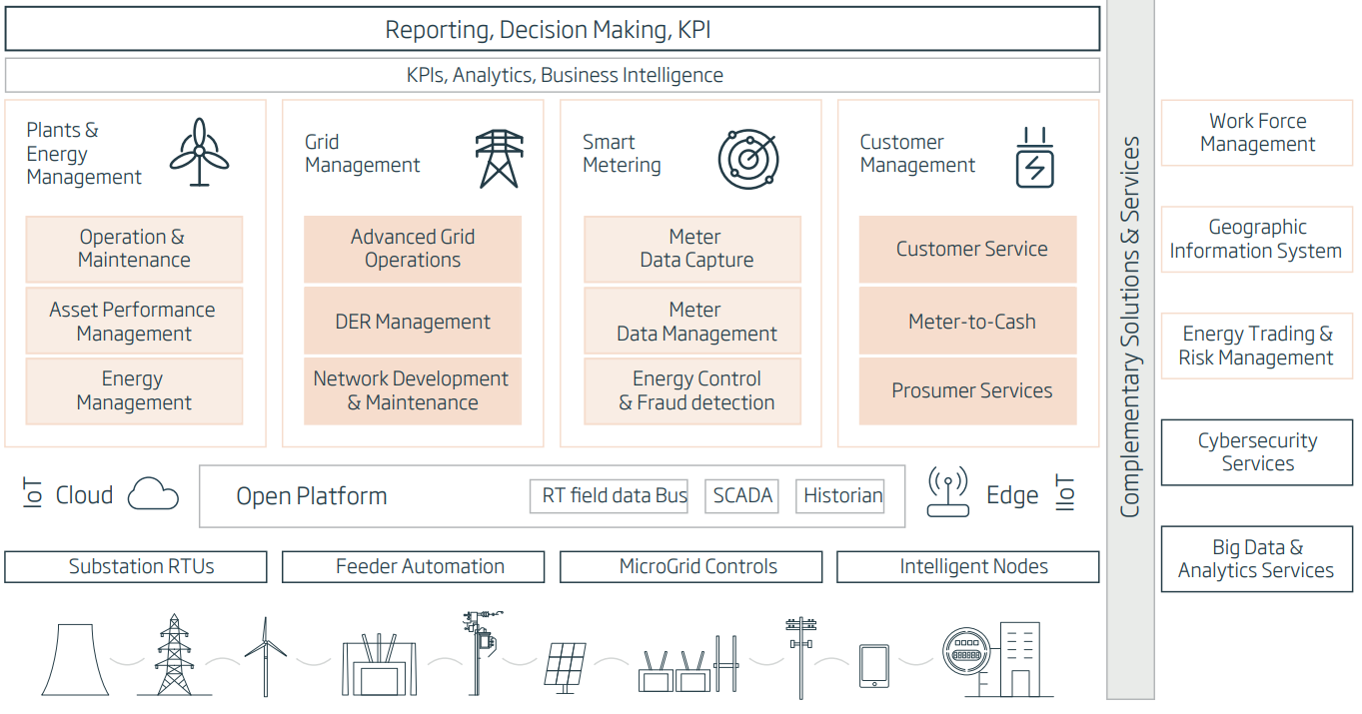
Indra VS Open Smartflex
The following is a comparison of OSF respect to Minsait functional scope
Complete Fulfillment
Alert
Partial Fulfillment
Competitive advantage
Indra end-to-end solution suite for utilities
Holistic CIS for Smart Service Providers
Out of scope
Out of scope
Out of scope
Facts
Even Indra offers solutions for the complete utility supply chain, OSF is a competitive vendor for Smart metering and Customer Management.
OSF supports advanced billing, which includes Prosumers billing models such as Net metering. However, it is necessary for Open working on a consolidated Prosumers and DER integration model, because Indra offers a special solution for prosumers.
We have strong capabilities for Fraud Management. However, it is not clear what Indra refers to Energy control.
Notes:
Mapping the pivotal functionalities of Onesait and OSF, we can realized that OSF cover the same scope of Indra’s CIS and MDM.

Slide 23
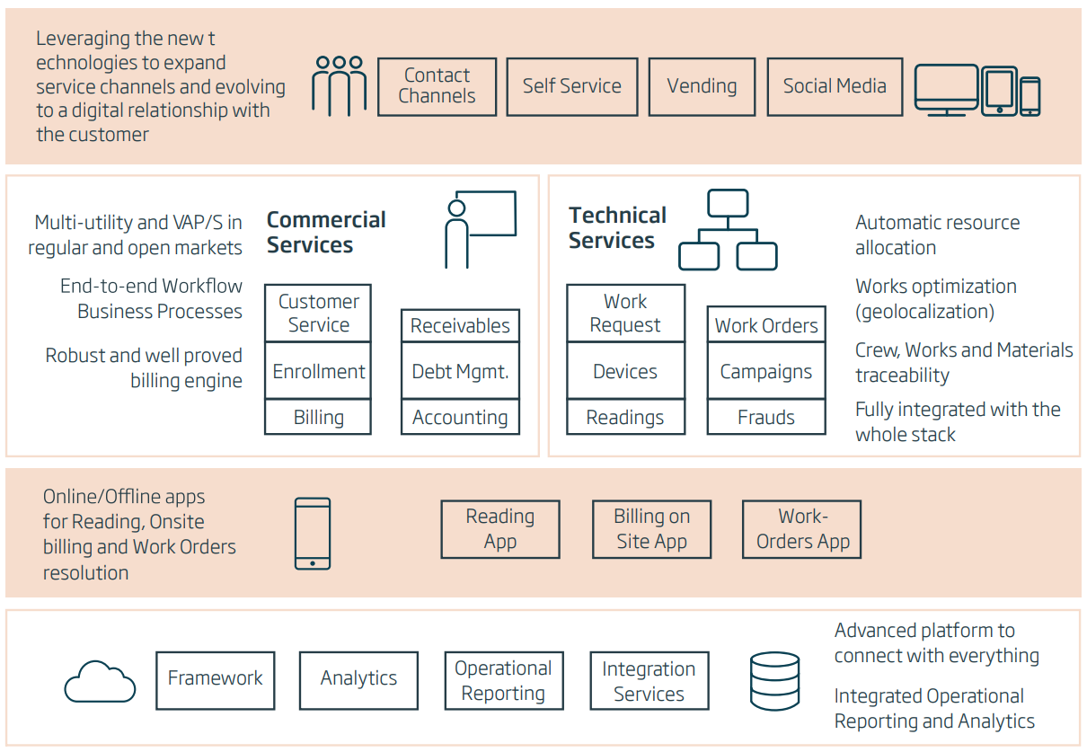
Indra VS Open Smartflex – CIS
The following is a comparison of OSF respect to Minsait functional scope
Complete Fulfillment
Alert
Partial Fulfillment
Competitive advantage
*
*Value added Products (VAP’s)
Notes:
VAPs = Value added Products (VAP’s)

Slide 24
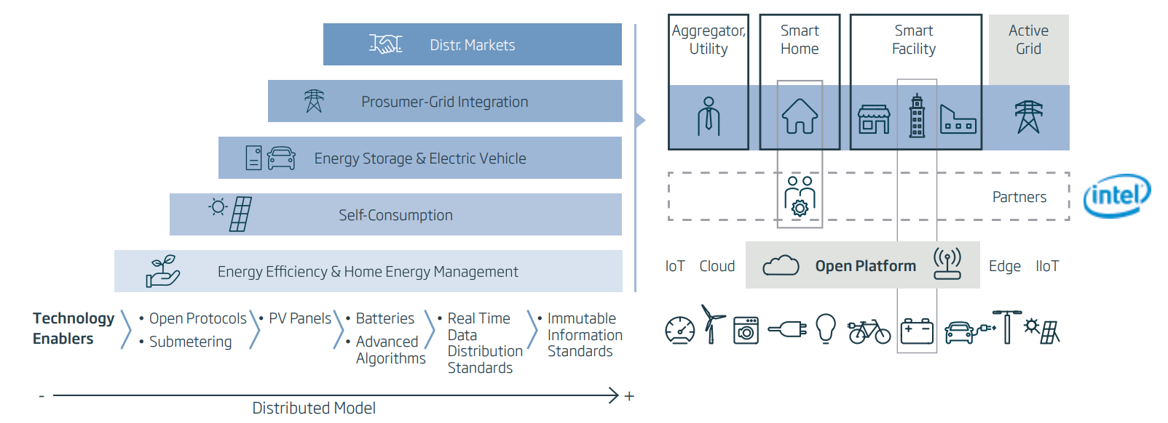
Indra VS Open Smartflex – CIS (prosumers)
The following is a comparison of OSF respect to Minsait functional scope
Complete Fulfillment
Alert
Partial Fulfillment
Competitive advantage
Out of scope
Onesait Prosumers is Minsait’s energy management solution for consumers.
Features
Multi-site Real-time monitoring of disaggregated consumptions and asset conditions.
KPI visualization and customized analytic dashboards.
Real-time control, assuring savings through automated processes.
Prosumer services and Active Grid services integration.
Accurate PV simulation from Smart Meter data, optimizing installation for customer preferred measure (Return of investment, Production Potential, etc.).
Market-place for customers, PV installers and credit entities.
Demand Response module for new energy services, such as Home Energy Management and additional home automation use cases.
Consumption and power alerts. Objectives management, defined in terms of energy and budget.
Integration with energy storage devices and EV charger.
Notes:
Indra se refiere a Active grid a una arquitectura basada en la integración de la energía distribuida y al monitoreo de la red. Los productos de indra se mueven bajo el esquema de esta arquitectura, con el fin de integrar DERs. Pra más info:indracompany.com/es/blogneo/active-grid-arquitectura-control-transformacion-electrico

Slide 25
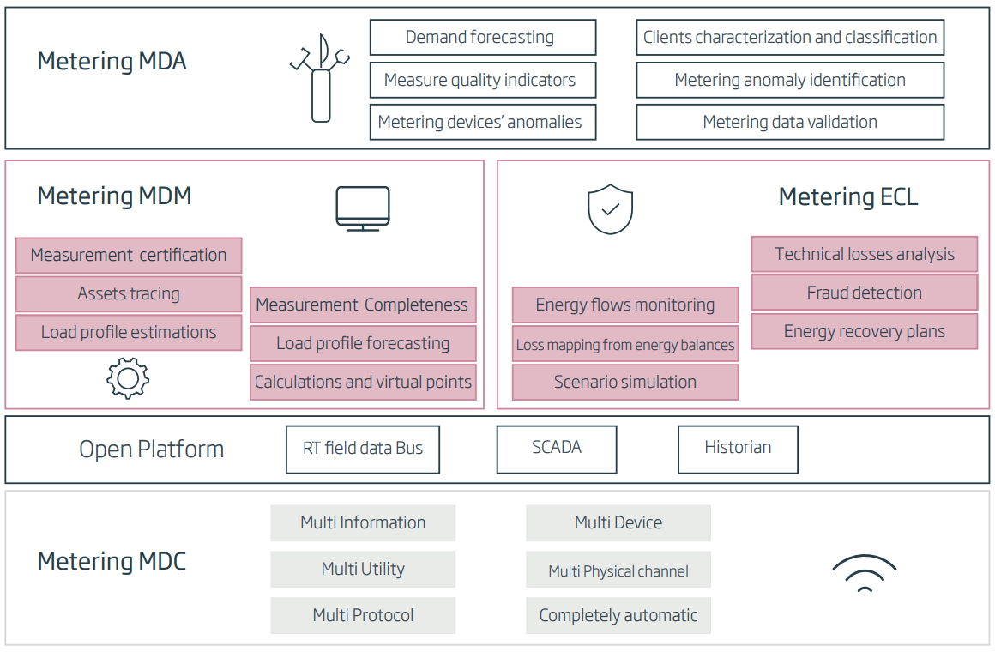
Indra VS Open Smartflex – MDM
The following is a comparison of OSF respect to Minsait functional scope
Complete Fulfillment
Alert
Partial Fulfillment
Competitive advantage
Features
Features
Meter data acquisition
Management of meter’s data acquisition.
Reading of Electric demand, events and Closings.
Meter’s Parameters Reading
Equipment Configuration (Software / Firmware)
Device reprogramming (Tariffs, Contracted power, ..)
Scheduled Process Monitoring
Network Status control
Supply connection and disconnection
Commands for Advanced Metering functionality is responsible for sending meter reading and start/stop service commands to AMI platforms, regardless of the communication protocol used by the meter's manufacturer.
Meter Data Processing supports the collection of massive reading data from smart meters, independent of the communication protocol used by the meter manufacturer. The gathered data are translated to a unified format for them to be used in subsequent processes.
Meter Data Capture (MDC) is the solution for the acquisition of data measurements (electric, gas or water) independently of the meter type or brand

Slide 26
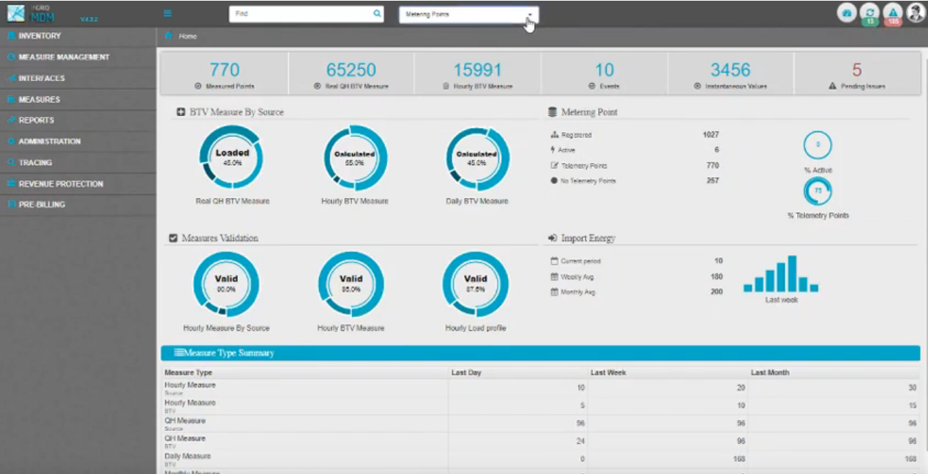
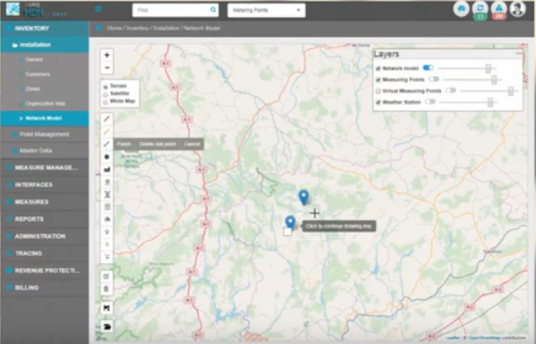
Indra VS Open Smartflex – MDM
The following is a comparison of OSF respect to Minsait functional scope
Complete Fulfillment
Alert
Partial Fulfillment
Competitive advantage
Meter Data Management (MDM) Supports the validation, edition, estimation, certification and exchange of information
Features
Features
Measurements’ validation, estimation and editing (VEE): outliers, completion, profiling Calculating virtual measurements, and aggregates.
Incorporates GIS features to allow the georeferenced treatment of the measurement as well as taking into consideration connectivity dependencies.
Time slots, Telemetered usage.
VEE Engine.
Device events.
Virtual metering.

Slide 27
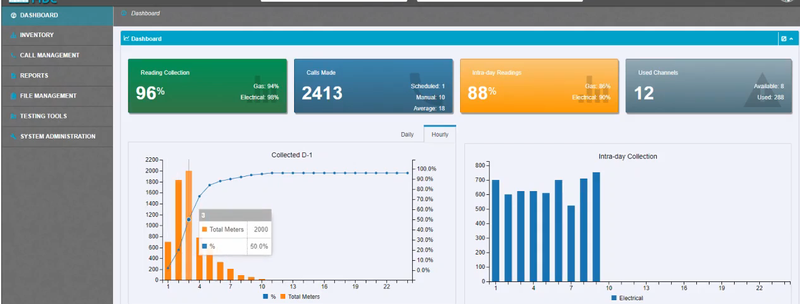
Meter Data Analytics (MDA) is an analytic platform oriented to the massive analysis of meter data, including advanced functions like forecasting or fraud detection
Indra VS Open Smartflex – MDM (Analytics)
The following is a comparison of OSF respect to Minsait functional scope
Complete Fulfillment
Alert
Partial Fulfillment
Competitive advantage
OSF does not provide the analytics but it does have capabilities to obtain many of these information
SAO 460142:
AMI Events Management covers Device events
Features
Customer demand forecast: short, mid and long term.
Identifying complex fraud patterns based on Big Data historical analysis.
Flexible management of business processes allowing the conditional linking of calculations, approvals, mailings.
Real-time detection of failure patterns.
Features
Current OSF scope does not cover analytics for Meter Data Management, However, our product is able to facilitate information devices’ events, meter data anomalies and data validation.
Notes:
• Customer demand forecast: short, mid and long term
• Identifying complex fraud patterns based on Big Data historical analysis.
• Flexible management of business processes allowing the conditional linking of calculations, approvals, mailings ...
• Real-time detection of failure patterns

Slide 28
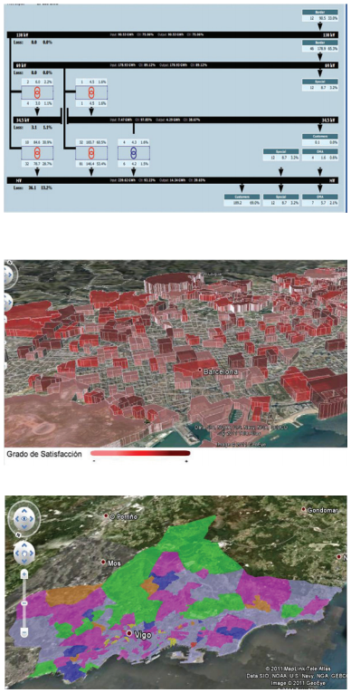
Indra VS Open Smartflex – MDM (Control and losses)
The following is a comparison of OSF respect to Minsait functional scope
Complete Fulfillment
Alert
Partial Fulfillment
Competitive advantage
Energy Control and Losses (ECL) allows a comprehensive control of flows across the distribution network, identifying losses (both technical and commercial) supporting revenue assurance.
Features
Features
Losses identification.
Simulation of losses/ Cost scenarios.
Energy balance, including global, cross and vertical balance.
Displays the list of potential customer fraud, monthly non-payment risk.
Inspection and collection campaign optimization.
The Non-technical losses functionality allows identifying network technical troubles or fraudulent connections.

Slide 29
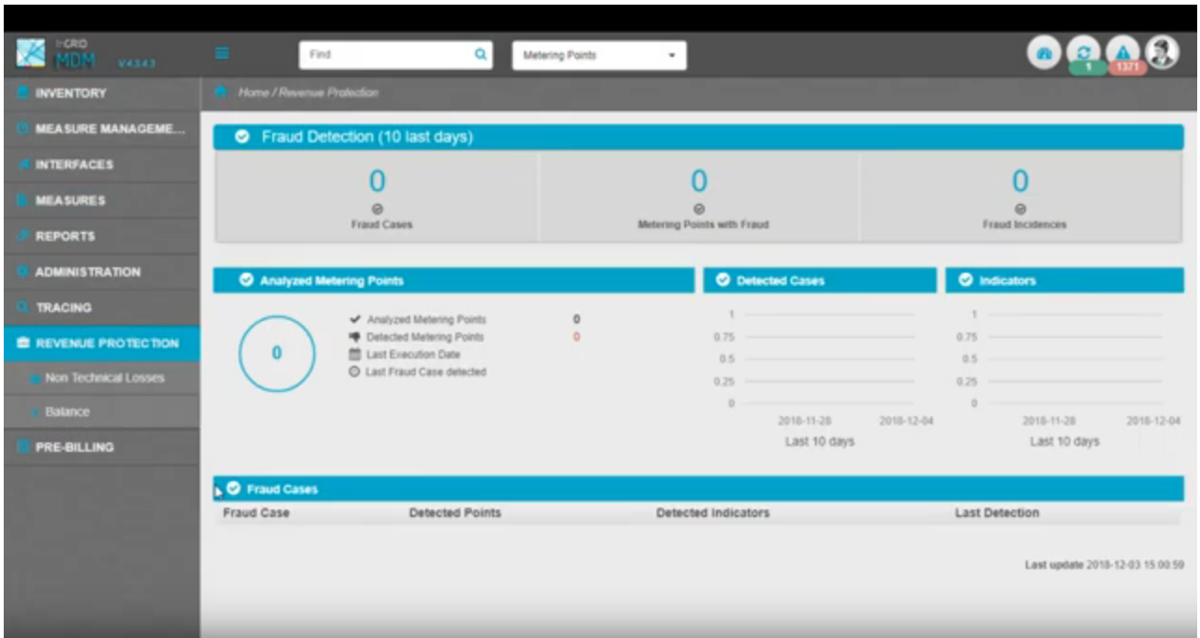
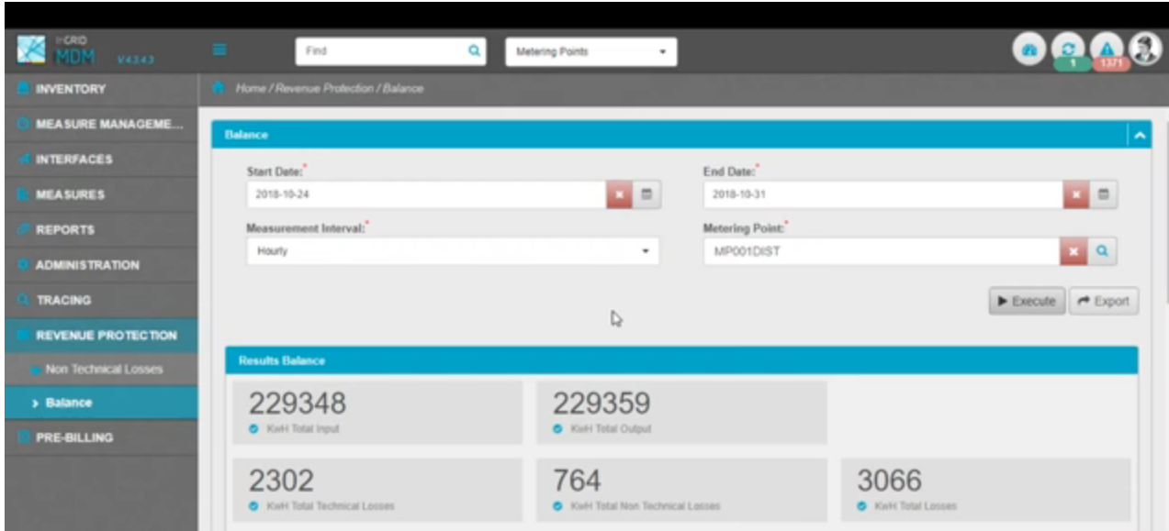
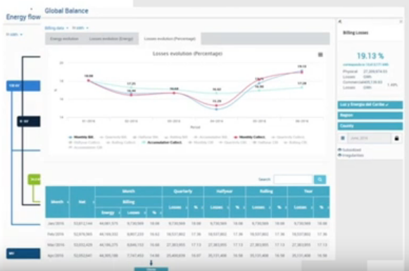
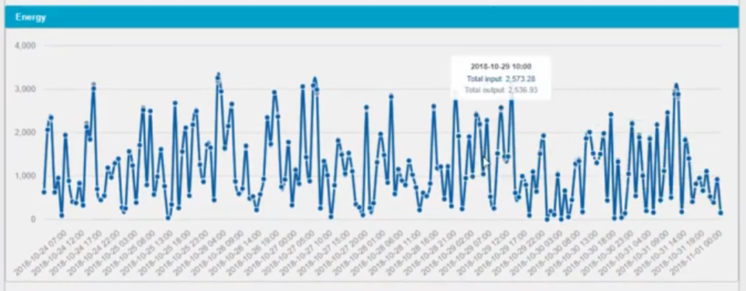
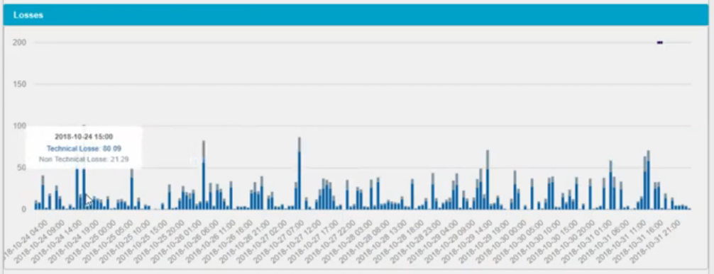
Indra MDM

Slide 30
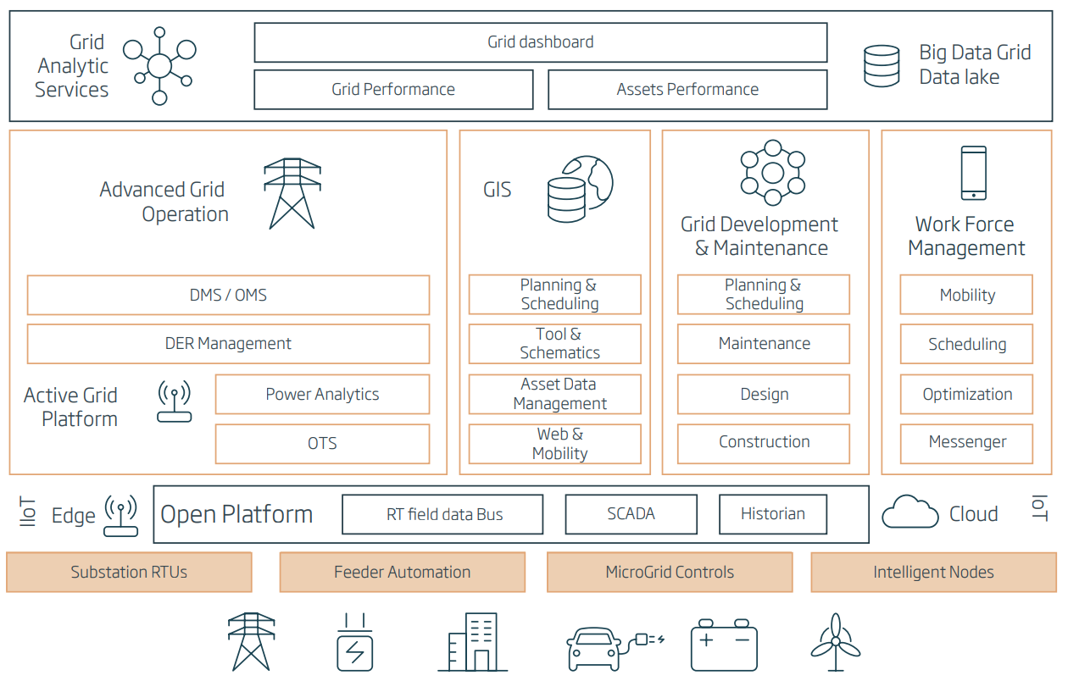
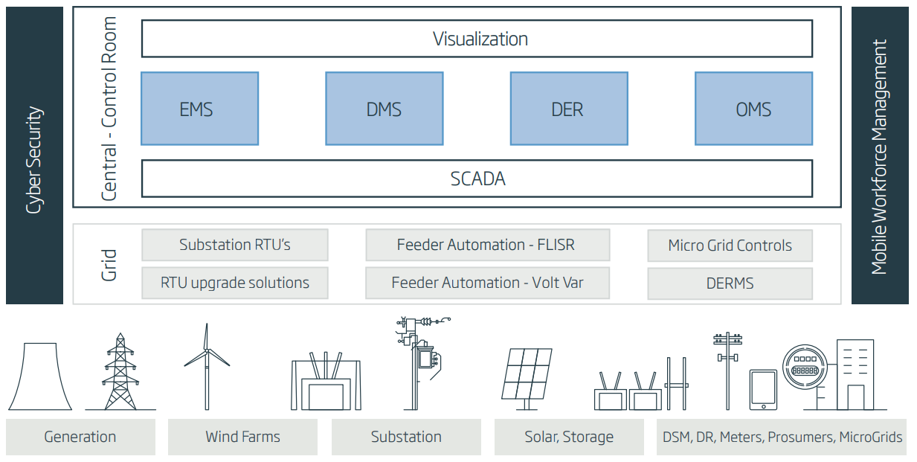
Other Minsait’s products
Indra Grid Management
Indra ACS
ACS supplies utility systems throughout the world with SCADA and many other advanced applications in a scalable platform that support both centralized and distributed architectures that optimize automation in the control room, at the substation, and the edge of the grid.
Onesait Grid is a comprehensive modular solution that fully supports transmission and distribution business processes, including the planning, development and maintenance of assets and the advanced and proactive Real-time control and operation of complex grids and distributed energy resources.

Slide 31
Onesait telecom
Features
Clients
Integration of Telecom Business Support Systems (BSS) and Operations (OSS).
Transmission systems, broadcasting, advertising management.
Digital TV and fiber networks deployment and monitoring solutions.
OTT communications.
Advanced analytics solutions focused on customer and network
Digital audiovisual content management systems.
Integrated solutions from Telco and New Media: OTT (IPTV), CMS-Player, Second screen.
Benefits
Up to 20% increase in the level of automated management of customer calls to the Contact Center.
70% reduction in Data Warehouse processing times over Big Data architecture.
ROI of less than three months for automation of manual backoffice processes.
Nearly 60% reduction in the costs of fiber optic monitoring processes.

Slide 32
MQ Gartner

Slide 33
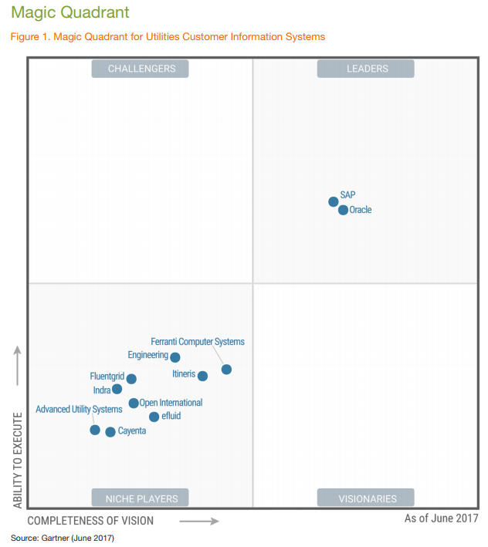
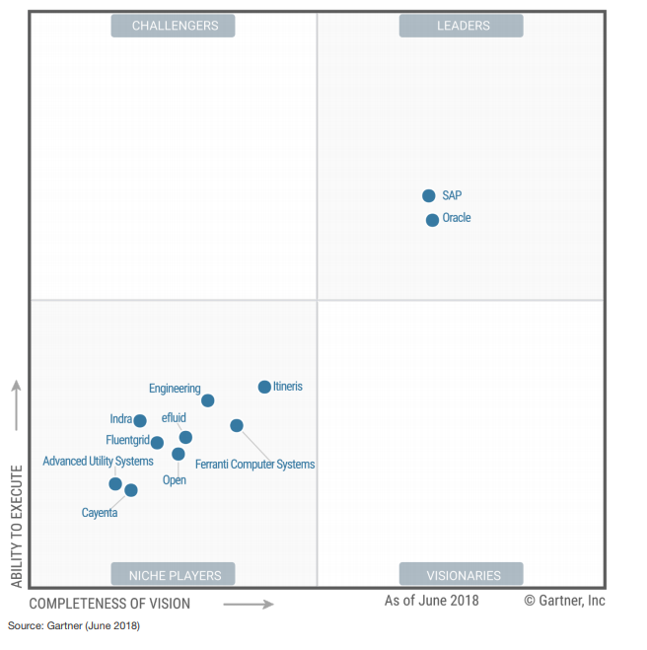
CIS MQ
MQ 2017
MQ 2018

Slide 34
Magic Quadrant
2017
2018
Strengths
InCMS is a functionally rich product with a footprint that extends beyond M2C and customer service into outage management and commodity management areas.
InCMS is a functionally rich product with a footprint that extends beyond M2C and customer service into outage management and commodity management areas.
Indra has a good presence in Spain, Latin America, Eastern Europe and Asia, and it continues to gain presence in Africa.
Indra has a good presence in Spain, Latin America, Eastern Europe and Asia, and it continues to gain presence in Africa.
References in general praise InCMS's suitability for energy utility business and ability to adopt to evolving market needs.
References rated InCMS high in areas of both batch and online performance.
Cautions
Multiple customers reported concern with implementation, which they felt was too long and required lot of customization.
Multiple customers reported concern with implementation, which they felt was too long and required lot of customization, with deadlines that were unreliable and difficult to achieve.
Although Indra has improved its market communication, some customers continued to express concerns with the lack of a clear migration path from legacy Indra CIS solutions to the current InCMS product.
Indra's solution has not been implemented in CIS markets in developed countries such as the rest of the EU, North America, Australia and New Zealand.
References on the legacy Indra CIS product rate ease of use as an area of concern, stating that user interface is not intuitive and requires multiple steps to accomplish a task.
Some references reported issues with Indra's slow responsiveness to their support needs.

Slide 35
Services

Slide 36
Service & Consulting
Strategic Consulting | Consulting services for different areas including operations, efficiency and outsourcing of processes, data management and predictive analysis, etc. Consulting services consist of detecting changes in business environments, understand their relevance and finally define strategic plans.
Digital Consulting and Technology | Consulting services for adopting new technologies related to digital experience, CRM and digital channels, digital operation, advanced analytics and artificial intelligence and data technology.
ERP Consulting | Implementation of ERP systems, certified with SAP and MS Dynamics. This service is focus on the implementation times and offering a complete and efficient coverage for hotels, major consumption, construction, promotion and renewable energies.
Cybersecurity | Development of security technologies, promoting digital business and protecting them, through a holistic approach based on risks and focusing on prevention, protection, detection and incident response. Services for digital identity, biometrics, digital signature, distributed cryptography, blockchain and artificial intelligence to create solutions with an impact on business and digital user experience.
Operations | Optimization of the customer’s operations, focusing on the client at all times, utilizing flexible integration, automation, digitalization and robotics technologies, as well as lean methodologies.
Consulting Services
Based on:
Strategy
Value proposition
Bussines model
Bussines plan
Operative plan
Solutions Implementation

Slide 37
Clients

Slide 38
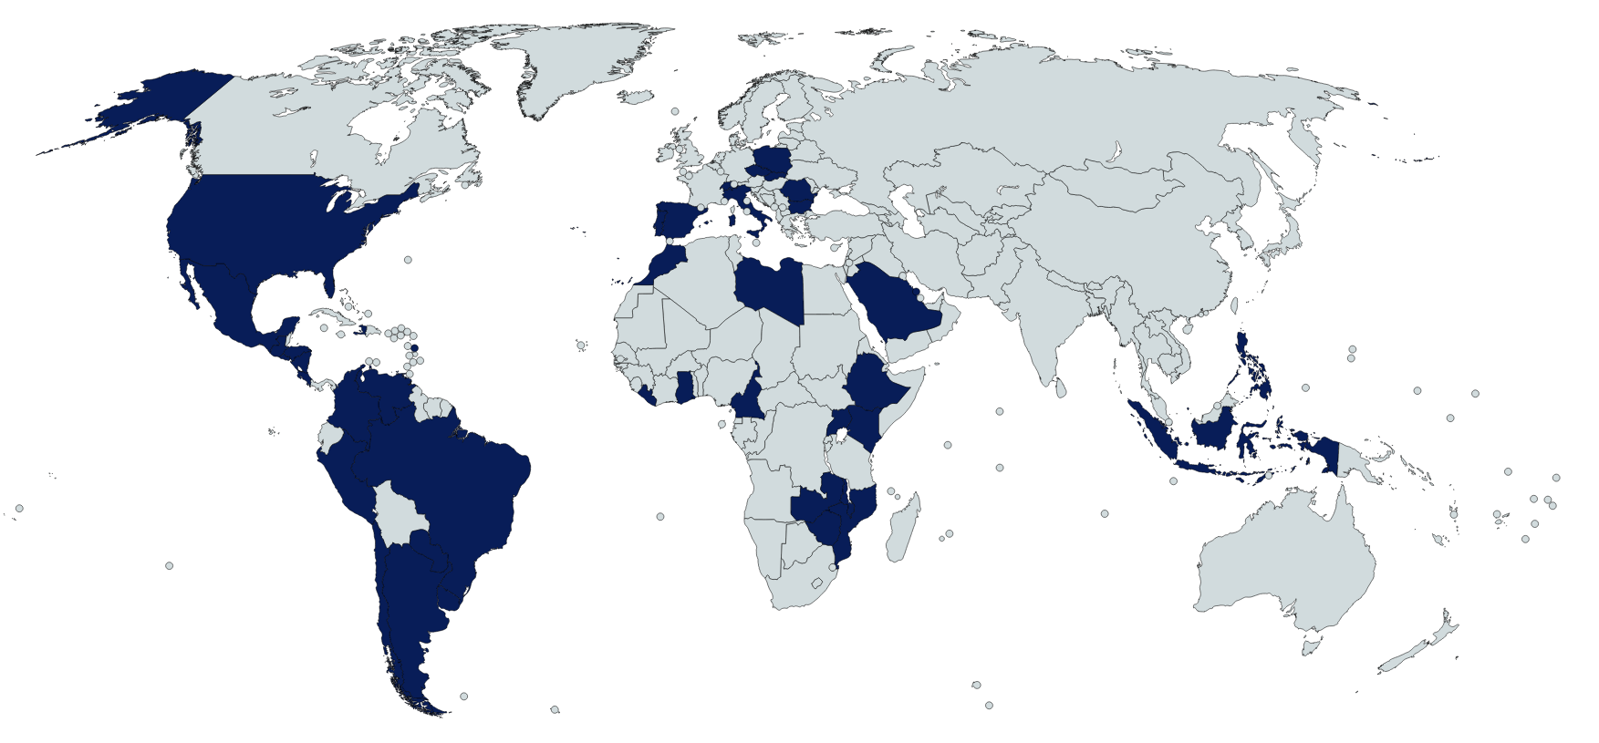
Indra’s customers worldwide
66%
America
8%
Europe
Chevron
Sempra
Aguas de Hermosillo
Servicios de Agua y Drenaje de Monterrey
SOAPAP
Aguas y Saneamiento de Toluca
AyA
ENEE
21%
Africa
CAESS
LESA
EEO
DEUSEM
EDH
3%
Asia
Edeeste
Edenorte/ Edesur
Energuate
Ecopetrol
EEC
Electricaribe
Epsa
Disnorte-Dissur
Osinergmin
PetroPerú
Sedalib
Sedapal
Electrodunas
Grupo EMEL
2%
Global
Aysa
Emdersa
ANDE
OSE
UTE
Conecta
*86 Clients of Indra were analyzed

Slide 39
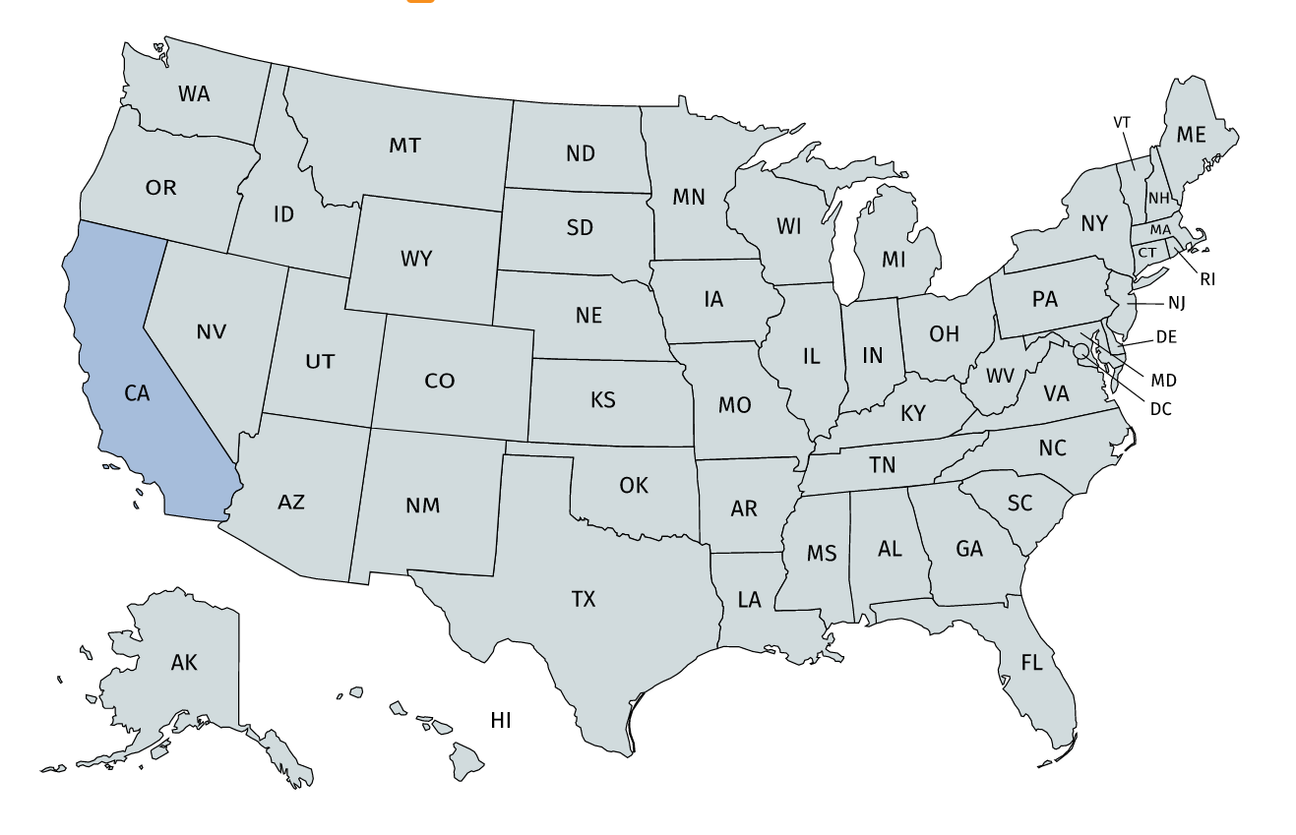
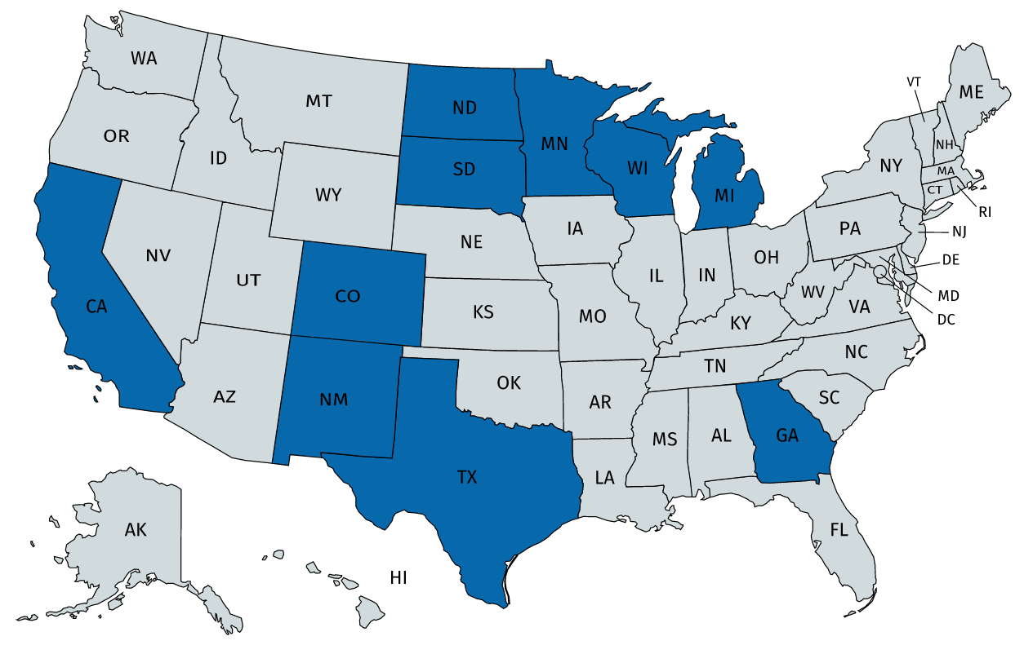
Indra in United States
With the adquisition of ACS, Indra accesses the markets of the United States, getting clients such as Xcel Energy, Cobb EMC, Georgia Power and SDGE, which have presence in California, New Mexico, Colorado, Texas, North Dakota, South Dakota, Wisconsin, Minnesota, Michigan and Georgia.
*86 Clients of Indra were analyzed

Slide 40
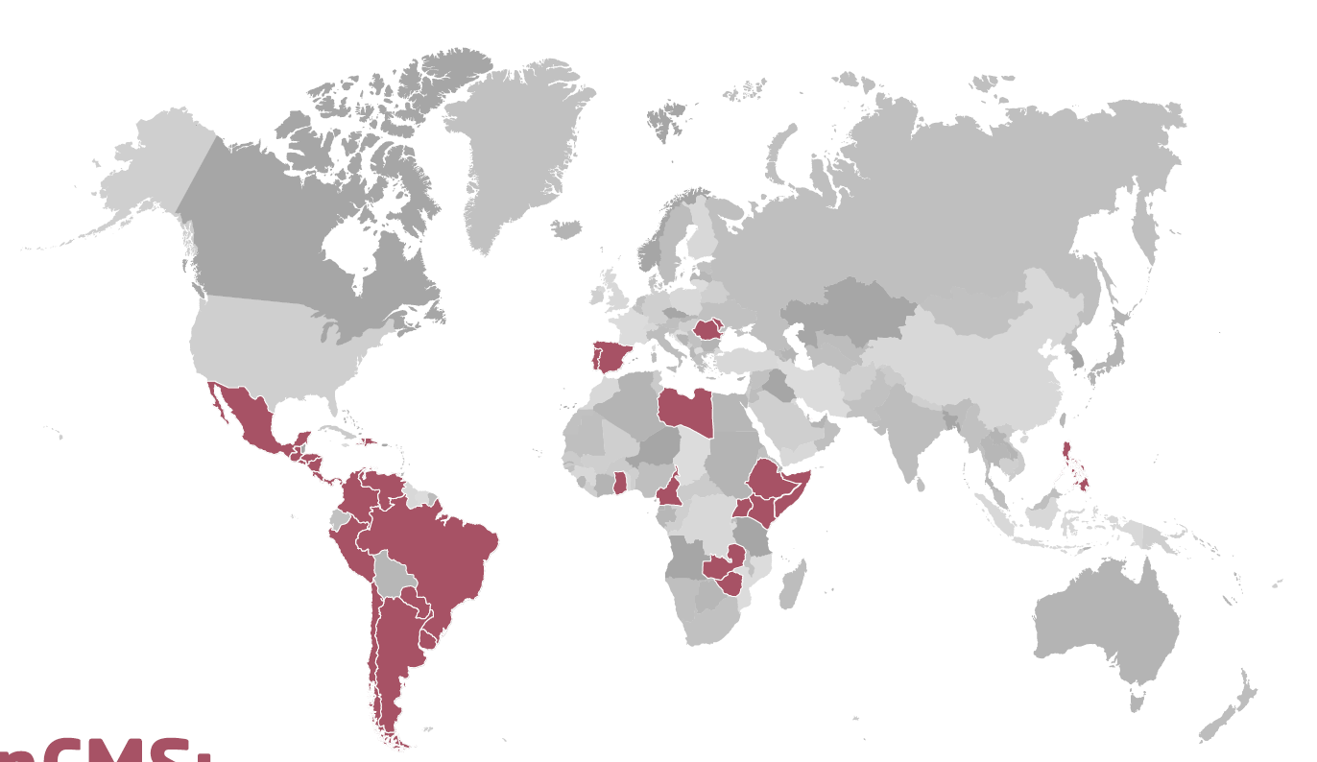
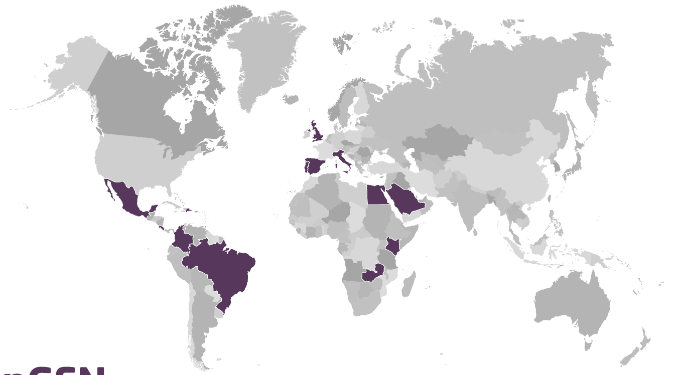
Indra’s customers by solution
InCMS clients
InGrid clients
Source: La razón, Indra, global leader in technology for utilities, 2016.
*86 Clients of Indra were analyzed

Slide 41
Indra’s customers – Overall view
Indra’s clients by industry
TOP 5 Indra’s customers
7,000,000 customers
CIS MWM MDM
**
4,500,000 customers
No information
4,000,000 customers
MDM
2,900,000 customers
CIS
2,850,000 customers
CIS MDM
REE is the the Indra’s client with the less amount of customers (2,000)
*86 Clients of Indra were analyzed
**EDP: Energías de Portugal

Slide 42
Indra’s customers – CIS view
Indra’s clients by industry
TOP 10 Indra’s customers
*86 Clients of Indra were analyzed
**EDP: Energías de Portugal

Slide 43
Indra’s customers
Purchase year
UTE (Uruguay) - InGRID Indra Distribution & Metering
KPLC (Kenya) – InCMS
AyA (Costa Rica) – InGRID WFM.
Liberia Electricity Corporation (Liberia) – InCMS, InGRID Indra Distribution & Metering.
CIS view
ESCOM (Malawi) – InCMS, InGRID Indra Distribution & Metering.
*45 Clients of Indra were analyzed

Slide 44
Indra’s Customer Factsheet
Indra signed a contract with Corporación Dominicana de Empresas Eléctricas Estatales (CDEEE) to implement its distribution network operation management system in EDEESTE, EDESUR and EDENORTE.
(2012)
Indra maintains a close relation with the Enel Group as a technology partner. It undertook the implementation of a CRM platform and information systems for different corporate and business divisions of Enel as well as the development of a global system for Enel Green Power to monitor wind farms.
In Argentina, Indra signed an agreement for three years with Aysa for supporting and upgrading SAP I-SU/CCS.
(2016)

Slide 45
An unsuccessful customer story
Factors affecting Indra reputation
ENEE took too long to go live with Indra's solutions and they have spent more money than was budgeted.
ENEE purchased three Indra's products including the commercial Management System (SGCinCMS), a Corporate Resource Management System (ERP-SAP) and an Incident Management System (SGI- inGRID).
Initial fee: $12,987,316.01 USD
EEH took over the software implementation.
ENEE, trying to the software go-live, invest 570,000 dollars more.
Both ENEE and EEH were able to make the software go live.
later addendum for $2.02 million dolars.
2014
2015
2018
2019
2013
The Software implementation project would exceed 30 million dollars and it is investigated by the Public Ministry.
ENERSA, EDEMSA, EDELAP, EDESA, EDEN, EDES, EDESAL, and ANDE have used Open SGC for more than 15 years, the software is obsolete and these utilities do not rely on Support services provided by Indra.
Notes:
http://dinero.hn/reactivan-software-estatal-de-facturacion-incms-para-que-eeh-reduzca-mora/

Slide 46
Events

Slide 47
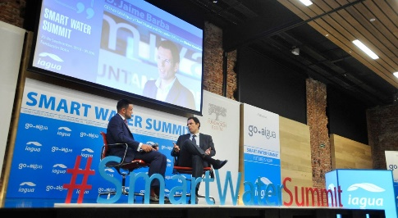
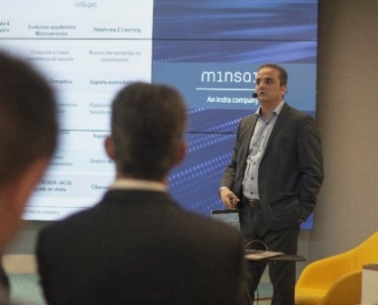
Events
Indra organizes:
Indra sponsors:
Mombaza
United States
Spain
Malasya
Smart Water Summit
In Europe, there is a similar event called the European Utility Week where will be presented two tracks of our interest related to Energy revolution and digitalization.
United States
Mexico
The future of cognitive technologies for the energy sector
Product training & workshop sessions, Solution & product sessions, Roadmap sessions, Customer engagement sessions, Customer success stories, Exhibitor showcase.
Experiences and key insights about the energy industry transformation
talks and specific use cases
Exhibitor showcases
Conference session • Panel discusions • Exhibitions • Networking •
B2B Matchmaking

Slide 48
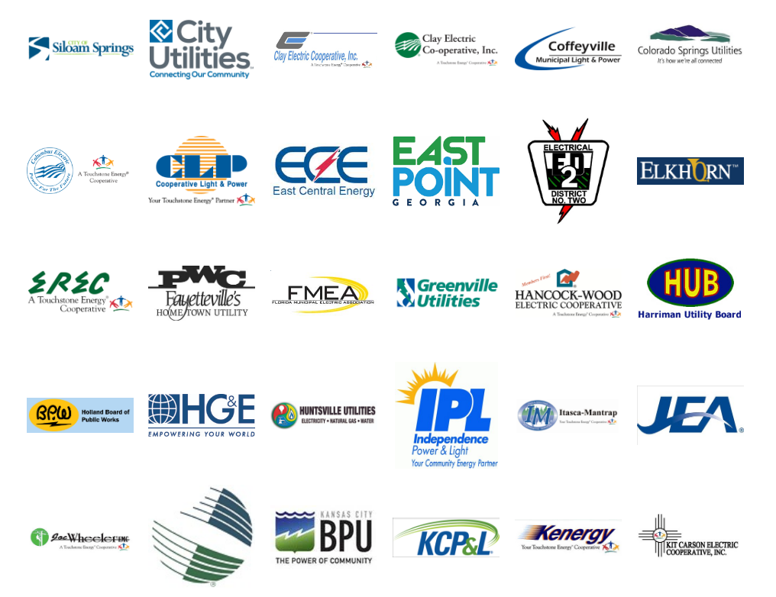
Events
October 27th-29th, 2019

Slide 49
Top topics
Digital transformation
Internet of Things
Advanced Analytics
Omnichannel
Customer centricity
Prosumers
Smart Grid
Artificial Intelligence
Blockchain
Cloud
Cybersecurity
AR/VR
Marketing Automation
Digital Marketing
Big Data
Done
To do

Slide 50
Partners

Slide 51
Indra’s Partner Network
Indra is part of Zigbee Alliance, a non-profit association for the creation and development of the standards on which the Internet of Things (IoT) is based.
Indra and Cisco sign a Memorandum of Understanding to Develop New Tecnologies and Solutions.
HCL has become the first partner to market InGRID Active Grid Management (AGM). HCL IoT will offer the InGRID AGM platform to sector companies in the United States and Canada.
Home automation research project led by Indra Software Labs.
To offer services to companies related to commodity trading and risk management (CTRM, Commodity Trading and Risk Management).
In 2011, during Cloud Academy Summit, CA Technologies and its partners Accenture, Capgemini, Cisco, everis, including Indra, showcased technological proposals for cloud computing strategy
Indra provides support and deployment of SAP solutions. SAP benefits from Indra's in emerging countries and in Latinamerica
Other partners

Slide 52
Pricing

Slide 53
Indra’s Licensing
Utility: Esval
Indra’s product: Open SGC
Year: 2014
Implementation
50 USD per hour - total of 16,200 hours implementation cost for this solution USD 810,000.
Interfaces with the ERP and GIS: 1,620 hours for a total cost of USD 81,000.
Licensing
1 USD per customer, therefore the license acquisition is USD 617,061.
Maintenance
The annual maintenance is USD 0.4 per supply, for a total of USD 246,824.
In the event of confirmation of this proposal, INDRA will grant ESVAL non-exclusive licenses for the use of the Open SGC system, for the commercial management of the number of clients that ESVAL has, and without limitation on the number of ESVAL users that must be defined to access the system.
More projects
Customers: 195,000 customers
Project’s cost: USD 13 million
Indra’s product: InCMS, inGRID, ERP-SAP
Year: 2013
Customers: No further information
Project’s cost: EUR 5 million
Indra’s product: Onesait Utilities Customers, Microsoft Dynamics AX
Year: 2019
Customers: No further information
Project’s cost: USD 749.565,10
Indra’s product: Management Information System (E-MIS), InCMS, InGRID.
Year: 2017
Customers: No further information
Project’s cost: USD 749.565,10
Indra’s product: “Integrated Commercial System”
Year: 2016

Slide 54
Why Indra (Esval)
Other competitors
CC&B is an agile product, however, Oracle is not located in Chile, so being the first client implementing this product lead to assume high costs because of the localization.
Finally, Indra is located in Chile, being Open SGC the product currently used by the Emel group of companies (Emelari, Eliqsa, Elecda, Emelat and Emelectric).
This solution appears within the Magic Quadrant.
Open SGC offers a multiservice solution to those companies that jointly manage several services at a reasonable cost.
With the implementation of OPEN SGC, it is possible to strengthen the management of the commercial area and offer users a better service in terms of processes such as invoice cancellation from any office, and the grouping of all contracts or services on behalf of the same user.
SAP (IS-U) does not have consultants with sufficient experience for implementations. In addition, some companies experienced serious problems with the billing, due to inadequate implementation of this product.

Slide 55
Acquisitions

Slide 56
Acquisitions
2016
Paradigma completes the value proposition of Minsait, Indra's business unit focused on digital transformation.
With this adquisition, Indra accesses the markets of the United States and Canada. Clients: Xcel Energy, Cobb EMC, Energuate, Bescom, Anaheim, Georgia Power, SDGE, SCANA, PNM.
Tecnocom adquisition stregnthens Indra’s leadership in information technologies, especially in financial services and other high-potential sectors. The adquisition is aligned with Indra's strategy of reinforcing its offer of digital transformation, especially in payment system solutions.
Indra started approximately in 1995, with the purchase of the company called Soluziona. Soluziona's customers kept the source code and made in-house modifications.
Through acquisition activities, Indra seeks to strengthen its product offerings

Slide 57
Innovations

Slide 58
Indra’s innovations
Smart Grid
Advanced analytics to reduce fraud and non-operational losses
Management of Distributed Energy resources, including solar panels, microgrids and electric vehicle
Demand Response, including consumption monitoring and Energy efficiency systems
IoT for control and action on the medium and low voltage grid, as well as incorporating renewable sources into the energy network and manage "microgrids".
Other topics
Omnicanality
Big data
Artificial intelligence
Digital reality
Cybersecurity
Blockchain
Data analysis
Repsol and Indra patent a system for the early detection of hydrocarbon leaks.

Slide 59
Indra’s innovations
Distributed Energy resources
Electric vehicle
Analytics
ICST-70/IST-120 Solar Tracker: Control system for energy production, environmental data, aiming position, and other variables monitoring safety conditions of the tracker and panels. Indra is has undertaken the following activities: System Specifications, design of the mechanical structure, development, and control of Software and Hardware, Integration and Testing.
THEROS- New Technologies For Smart Windmills Conservation: Indra will analyze data from different sources to detect, diagnose and predict possible failures of the wind turbine.
PRICE-GDI- Distributed Generation Management: Indra is working on the specification of the real-time reference platform for DG control and supervision.
IoE (Internet of Energy): Indra will optimize the duration of hybrid vehicle batteries and define the requirements for the control of energy and economic transactions resulting from the integration of electric vehicles to the current and future smart grid.
MUGIELEC: It optimize the energy supply to electric vehicles in recharging public places or recharging in homes or private parking spaces. Indra is responsible of designing of domestic system for the connection to the electric vehicle's network and the development of computer systems to improve energy efficiency with the support of the electric vehicle.
PRICE-RED: Indra will provide an advanced analytics ecosystem based on Cloud and Internet of Things (IoT) platform for failure diagnosis and prognosis models to better understand the real time behavior.
TEDS4BEE: Indra will collect, store and analyze consumption data and other parameters that influence energy consumption such as temperature, humidity, NOx, CO2, comfort level, light intensity, etc. to identify actions to improve energy efficiency.

Slide 60
Indra’s innovations
Minsait IoT Platform Sofia2
Demand Response / Energy efficiency
Smart Grid - Network
The Minsait Internet of Things platform with big data and cloud capabilities, drives city transformation via the development of solutions aimed at generating value for the general public. The platform acts as middleware and repository, enabling real-time interoperability between systems, networks, devices and sensors. Based on the data received and prior knowledge accumulated through analytical techniques and machine learning, rules can be designed and actions triggered. It also incorporates powerful georeferenced visualization tools for all information.
PRICE-GDE: Consumption monitoring system for customers that allows the implementation of Intelligent Demand Management of the electrical system. Indra will be responsible for the development of an active demand management office and new recharging devices for electric vehicle.
ARROWHEAD: Indra will design, implement demonstrator an energy efficiency system in Barcelona that includes a smart lighting solution and an advanced energy efficiency system in buildings
3e HOUSES: “Energy Efficient e-HOUSES”: Indra will integrate customers in the energy system using Information Technology (TIC), allowing them to develop and improve their relation not only with the utility company, but also with the power grid.
PRICE-RED: Intelligent and interoperable network platform through the integration of systems and equipment in the network of transformation centres that allow the supervision and automation of the entire distribution network. Indra is focused on the analysis of the ICT technologies that are best integrated into the smart grid respect to middleware systems and real-time data storage.
SAPPIEMS: System for advanced management measurement and network operation needs. Indra will research how the different elements of the grid can interact through an ICT platform to improve operational network, investigate and develop new business models that are emerging with the integration of new systems (smart metering) and new technologies (power electronics solid state).

